Slide 1
Finding Sources
For the Object essay, I’m asking you to include three sources for your paper.
Other than me telling you (which isn’t a great reason) why do we include sources in our essays?
What kinds of sources do we want to make sure we are including?

Slide 2
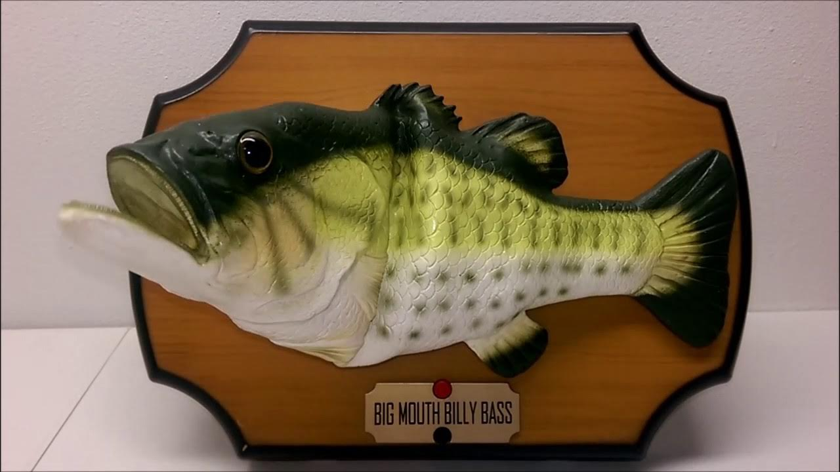
Source Scavenger Hunt
For this activity, we will be finding facts and sources about the Bigmouth Billy Bass
Notes:
https://www.youtube.com/watch?v=fkYZ4wTBd8g

Slide 3
Source Scavenger Hunt
For this scavenger hunt, I want each of your groups to tell me three facts about the Bigmouth Billy Bass that come from three different sources.
  1 Fact about how it works
  1 Fact about how it was invented
  1 Fact about its cultural impact or legacy
You can all search separately or together as part of this to assemble your three facts.
Afterwards, we will be reflecting on your search, so keep those tabs open!

Slide 4
Source Scavenger Hunt Reflection
How did you begin looking for your sources?
Did you rule out any potential sources as you searched? Why?
What about the sources you selected made you feel like they were trustworthy?
Did your sources conflict over any information? If so, over what?
Did you note any biases in your sources or searches? If so, where?

