Slide 1
Description
As part of Writing Project 1, you are expected to write a detailed description about your object.
In general, this might consist of how it looks, sounds, smells, tastes, or feels.
Why is this important? What do we hope to accomplish via description?

Slide 2
Example: Kimmerer on Strawberries
You could smell ripe strawberries before you saw them, the fragrance mingling with the smell of sun on damp ground. It was the smell of June, the last day of school, when we were set free, and the Strawberry Moon, ode’mini-giizis. I’d lie on my stomach in my favorite patches, watching the berries grow sweeter and bigger under the leaves. Each tiny wild berry was scarcely bigger than a raindrop, dimpled with seeds under the cap of leaves. From that vantage point I could pick only the reddest of the red, leaving the pink ones for tomorrow.
Even now, after more than fifty Strawberry Moons, finding a patch of wild strawberries still touches me with a sensation of surprise, a feeling of unworthiness and gratitude for the generosity and kindness that comes with an unexpected gift all wrapped in red and green. “Really? For me? Oh, you shouldn’t have.” After fifty years they still raise the question of how to respond to their generosity. Sometimes it feels like a silly question with a very simple answer: eat them.
Notes:
Ask students what stands out to them.

Slide 3
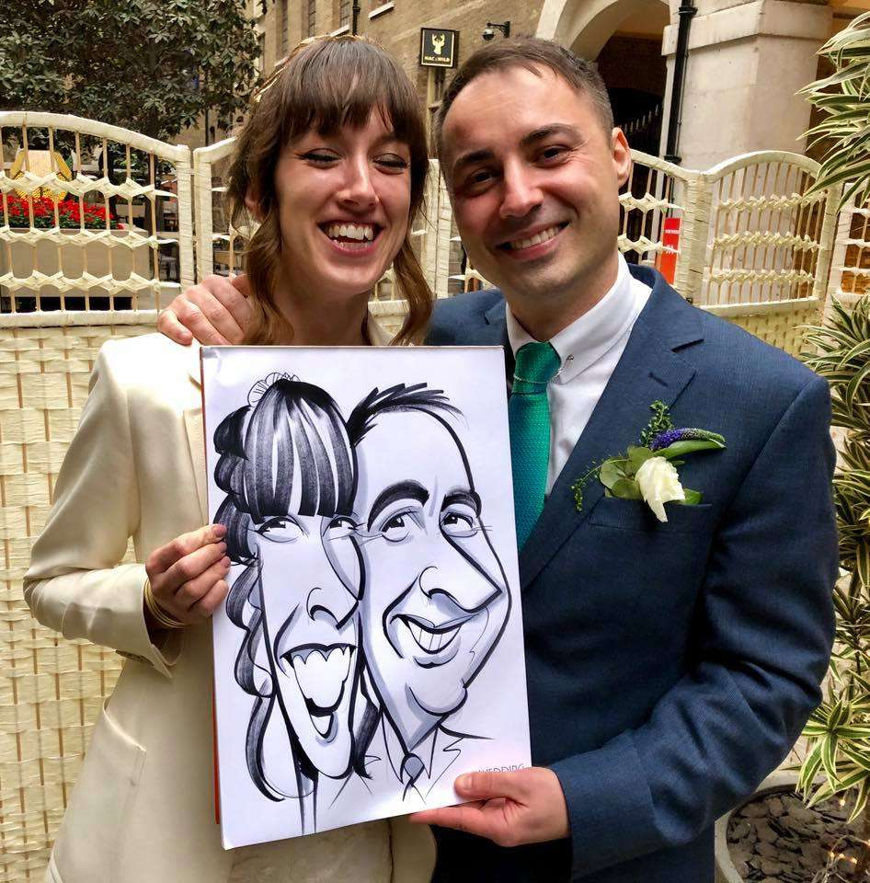
Description
Description is a critical act, where you decide what to emphasize, what is meaningful about your object that you need to share.
What is meaningful for one person may not be meaningful to someone else.

Slide 4
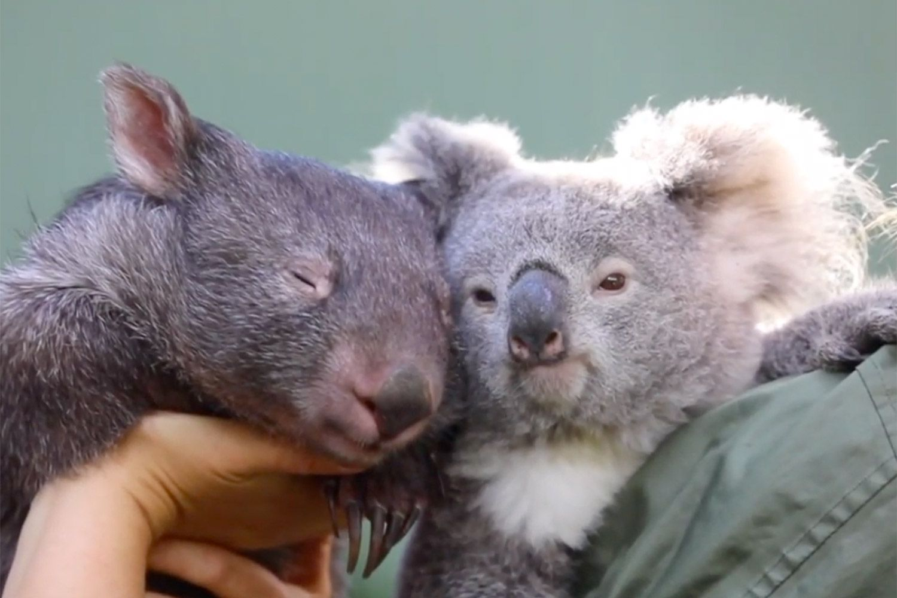

Slide 5
Groups
Group 1:
Group 2:
Group 3:
Group 4:
Group 5:

Slide 6
Activity
Each group will draft an object and two genres.
Without consulting your groupmates, write a brief description of your object (1-2 paragraphs) for each of your different audiences.

Slide 7
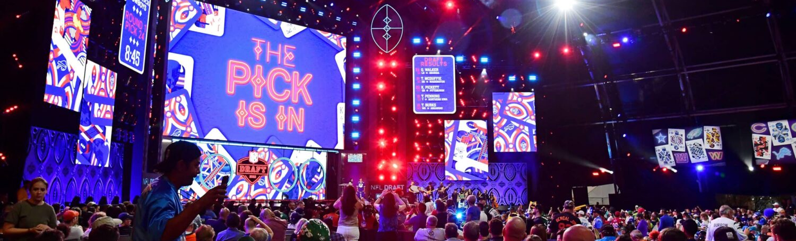
Genre Draft
A Children’s Book
A Newspaper Article
An Academic Essay
An Unboxing Vlog
Scientific Description
An Online Review (Amazon, for example)
An email to a professor (perhaps detailing why you were late to class)
A Nature Documentary
A Fantasy Epic
Text Messages to a friend

Slide 8
Reflection
Share your descriptions with your groupmates, then discuss the following questions:
What aspects of the object did you emphasize? Why?
How did you change what you wrote based on the genre? Why?
What do you define as meaningful in your two descriptions? How could those be potentially meaningful for you/your audience?
What did you leave out of your descriptions? Why is that possibly not meaningful to your audience?

